Slide 1
Drinking Water Quality Detection Using Machine Learning Techniques
A04

Slide 2
Architecture
User Interface
Random Forest
Support Vector Machine

Slide 3
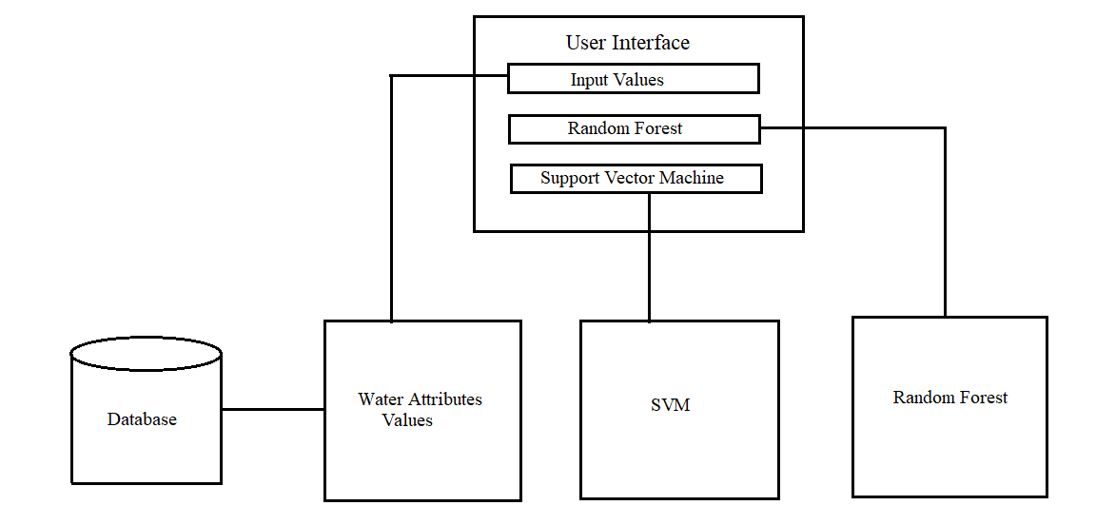
Architecture

Slide 4
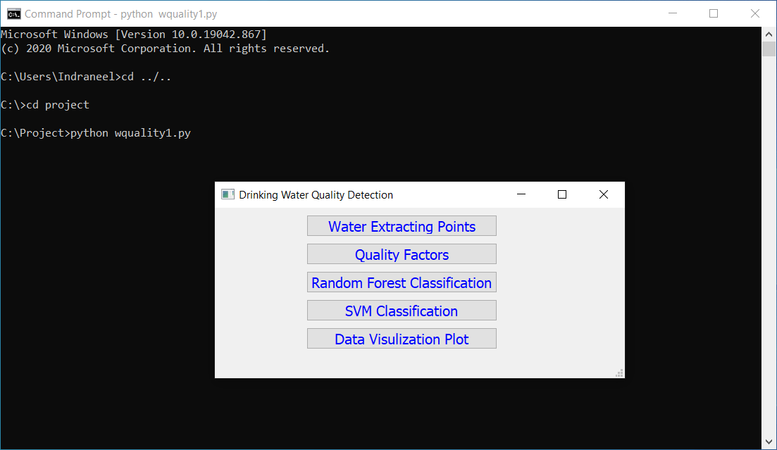
User Interface

Slide 5
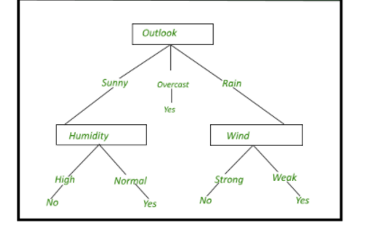
Decision Tree Classifier

Slide 6
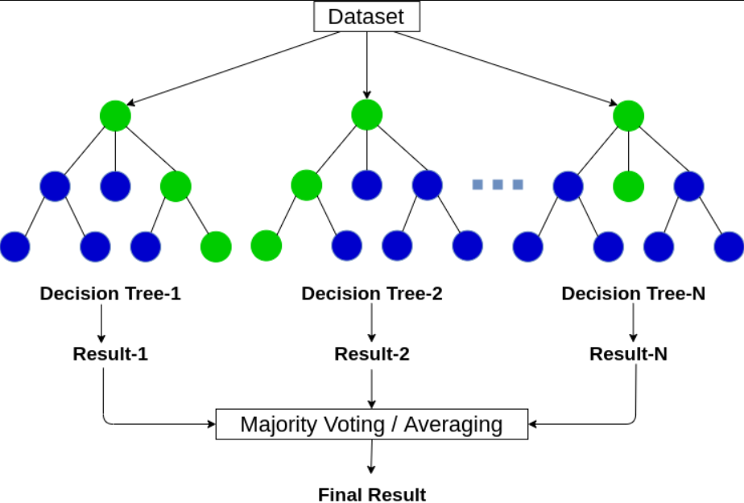
Random Forest

Slide 7
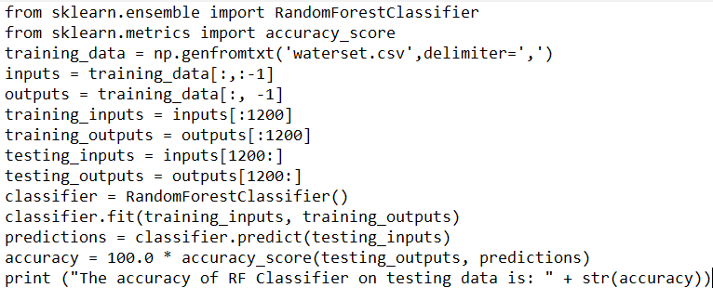
Random Forest

Slide 8
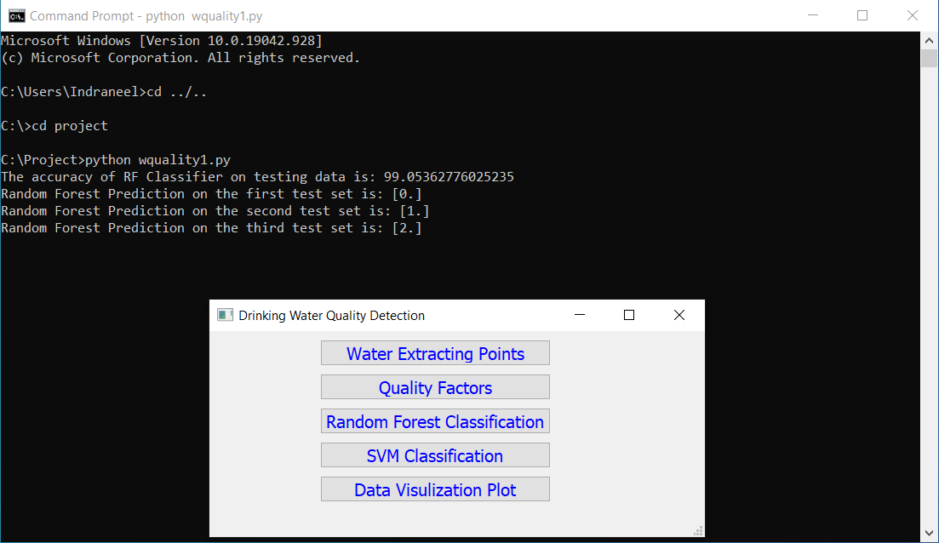
Random Forest

Slide 9
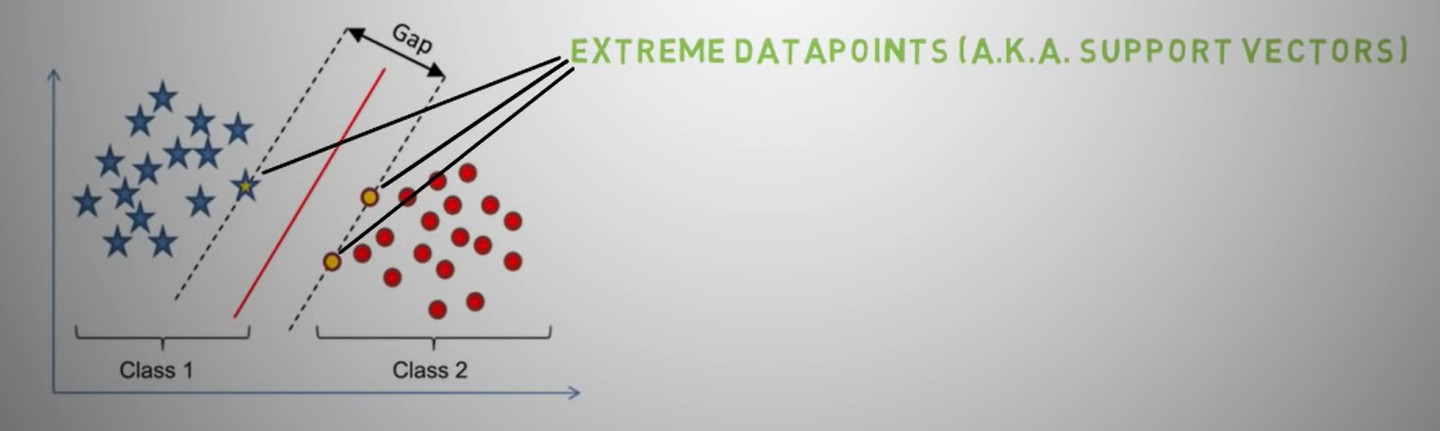
Support Vector Machine
Support Vector machine is suited for extreme cases
It is best at segregating the two classes

Slide 10
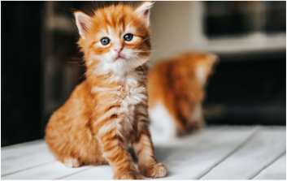
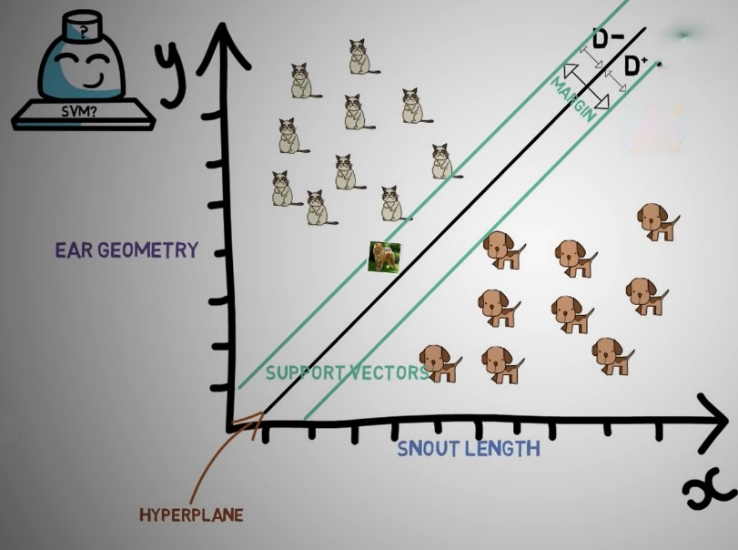
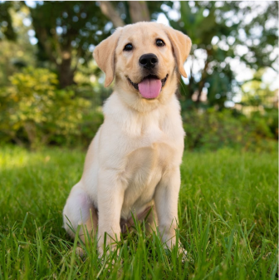
Support Vector Machine
Classifying an image into dog and cat

Slide 11
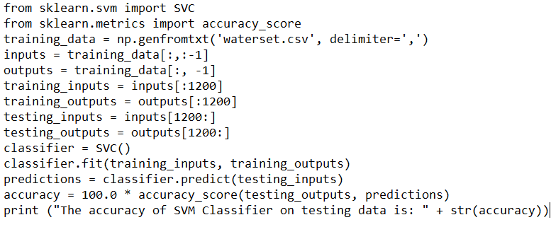
Support Vector Machine

Slide 12
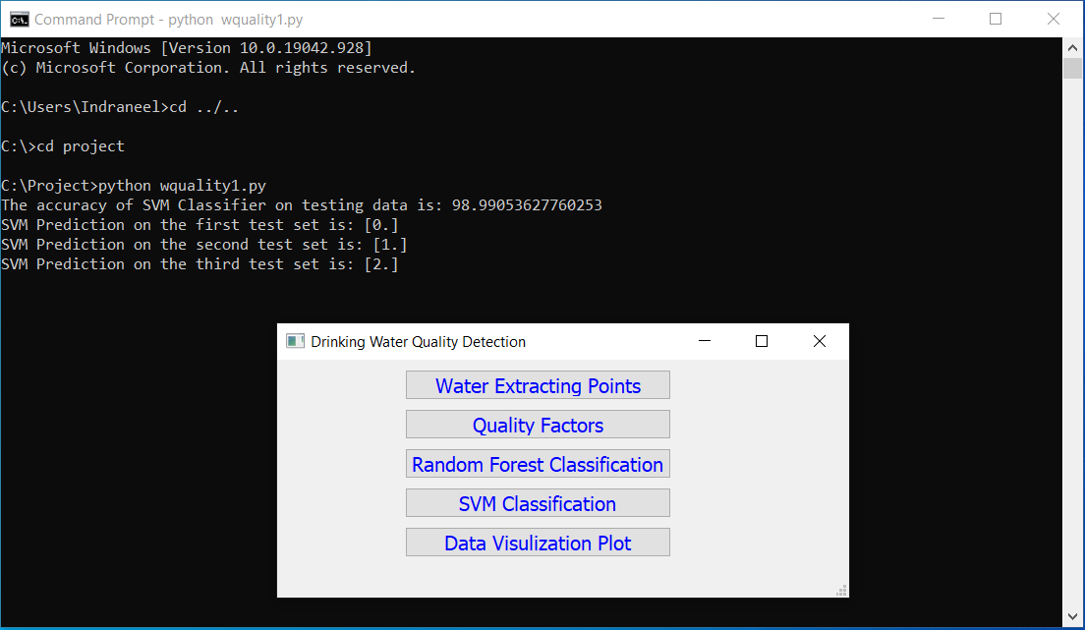
Support Vector Machine

Slide 13
Thank you
K. B. Indraneel (221710301030)
D. Akhil Kumar (221710301012)
O. Sai Ram Reddy (221710301046)
A. Kartheek (221710301004)

